Slide 1
Section 12.7
Systems of Inequalities
Copyright © 2012 Pearson Education, Inc. Publishing as Prentice Hall.

Slide 2

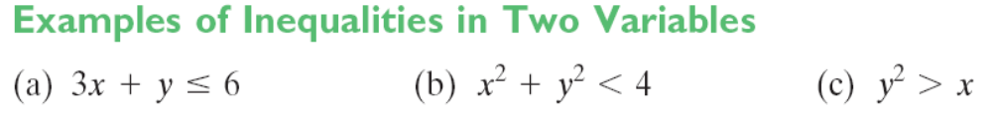
Copyright © 2012 Pearson Education, Inc. Publishing as Prentice Hall.

Slide 3

Copyright © 2012 Pearson Education, Inc. Publishing as Prentice Hall.

Slide 4

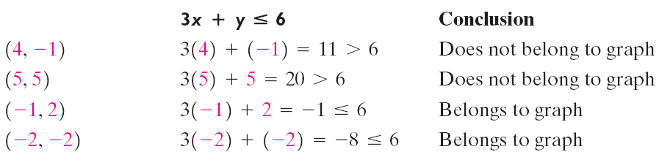
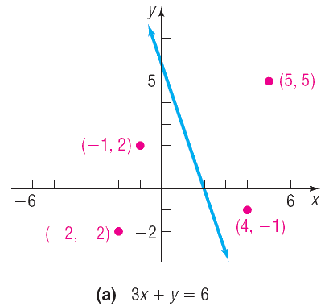
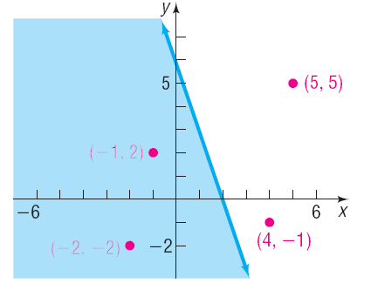

Copyright © 2012 Pearson Education, Inc. Publishing as Prentice Hall.

Slide 5
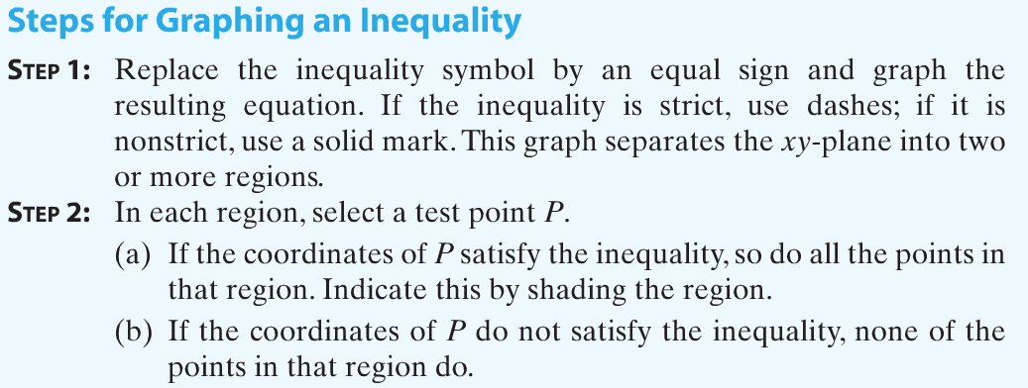
Copyright © 2012 Pearson Education, Inc. Publishing as Prentice Hall.

Slide 6

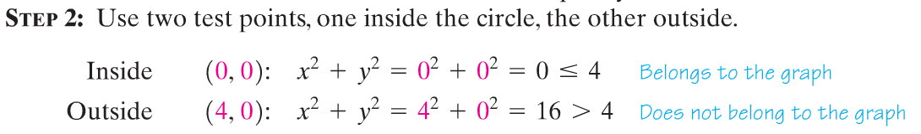
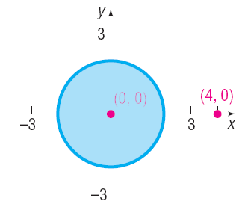
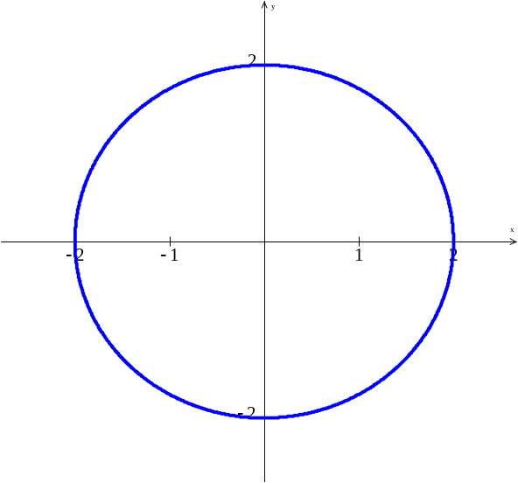

Slide 7

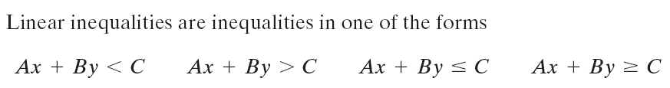
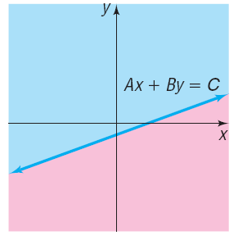
Half-planes
Copyright © 2012 Pearson Education, Inc. Publishing as Prentice Hall.

Slide 8

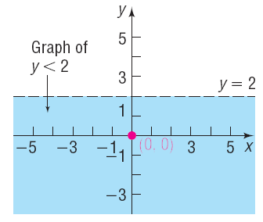
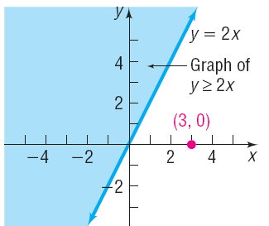
Copyright © 2012 Pearson Education, Inc. Publishing as Prentice Hall.

Slide 9

Copyright © 2012 Pearson Education, Inc. Publishing as Prentice Hall.

Slide 10

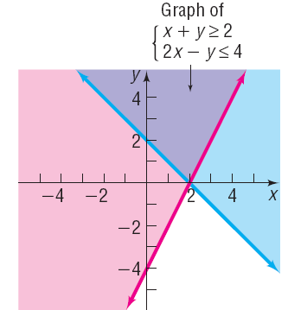
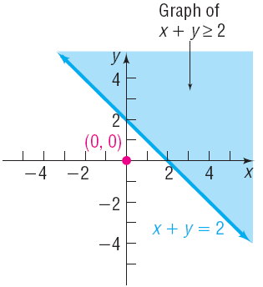
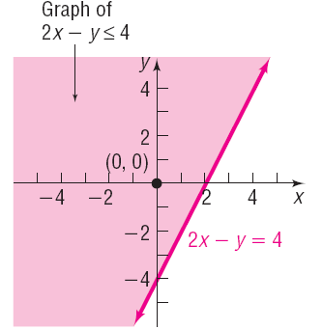
Copyright © 2012 Pearson Education, Inc. Publishing as Prentice Hall.

Slide 11

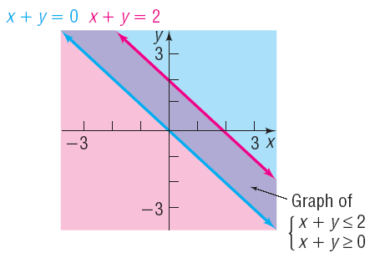
Copyright © 2012 Pearson Education, Inc. Publishing as Prentice Hall.

Slide 12

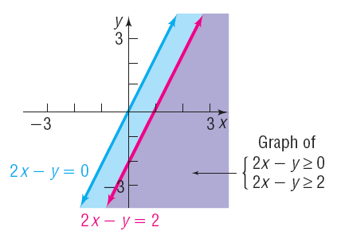
Copyright © 2012 Pearson Education, Inc. Publishing as Prentice Hall.

Slide 13

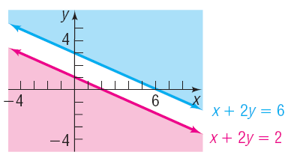
Copyright © 2012 Pearson Education, Inc. Publishing as Prentice Hall.

Slide 14
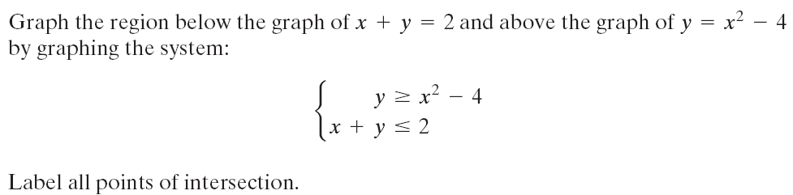
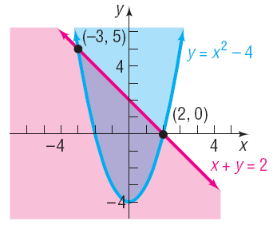
Copyright © 2012 Pearson Education, Inc. Publishing as Prentice Hall.

Slide 15
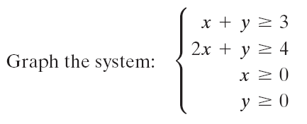
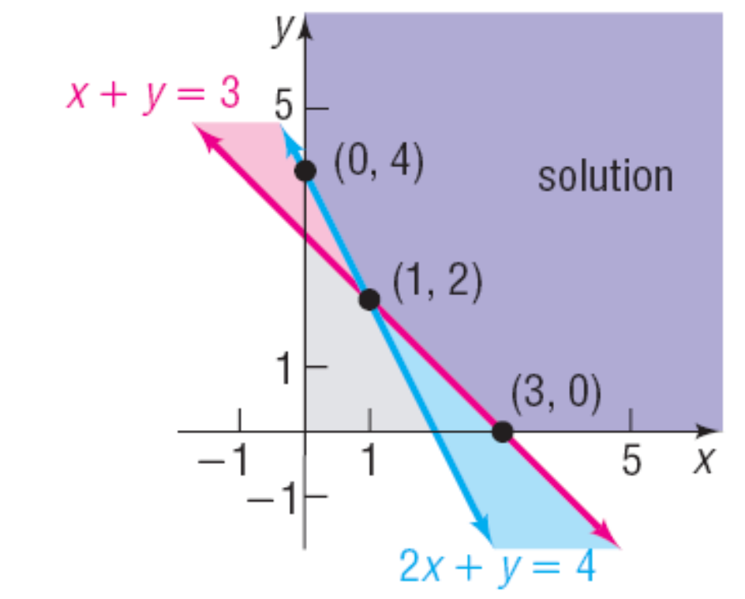
Copyright © 2012 Pearson Education, Inc. Publishing as Prentice Hall.

Slide 16

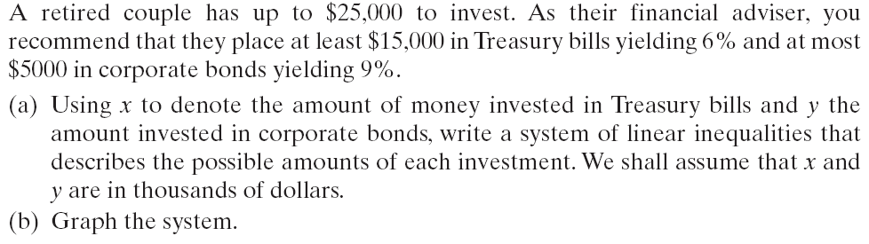
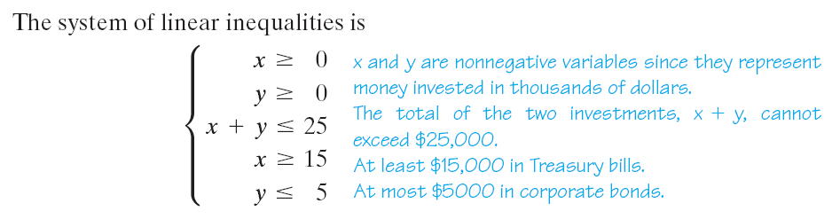
Copyright © 2012 Pearson Education, Inc. Publishing as Prentice Hall.

Slide 17
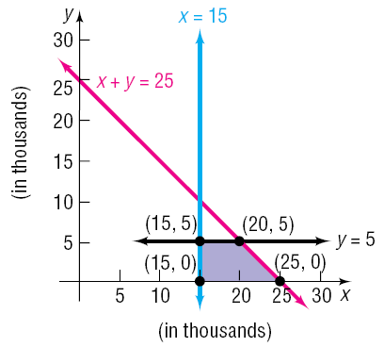
Copyright © 2012 Pearson Education, Inc. Publishing as Prentice Hall.

